Slide 1
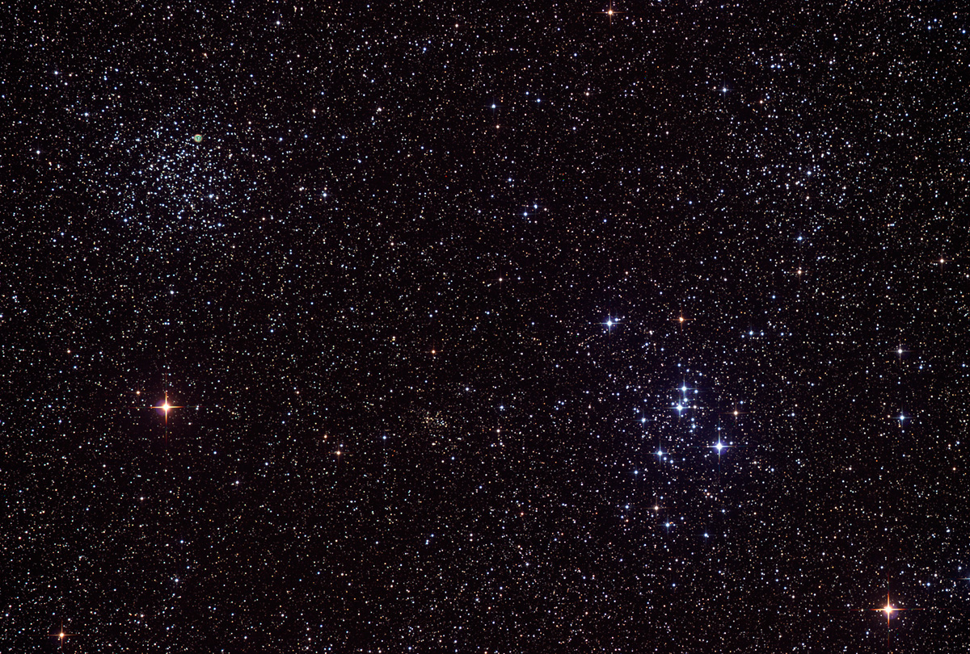

Howard
Astronomical
League
13
April 18, 2013

Slide 2
Stumper Question

Slide 3
As of last night, how many asteroids are visible naked eye (mag < 7)?
None
About 16
About 128
About 1024
About 4096

Slide 4
Dr. Jason Kalirai, STScI The Hubble Space Telescope's New Frontier Fields: A Prelude to the James Webb Space Telescope
Notes:
Dr. Jason Kalirai is a research astronomer at the Space Telescope Science Institute in
Baltimore, MD. He obtained his PhD in astrophysics in 2004 from the University of British
Columbia in Vancouver, BC, Canada. His research interests include studying the formation
and evolution of stars and nearby galaxies using both ground and space based telescopes.
Dr. Kalirai is also the Deputy Project Scientist for the James Webb Space Telescope.

Slide 5
Upcoming club activities

Slide 6
Star Parties!
April 20th – Public Star Party
May 4th – Members only Star Party
May 18th – Public Star Party

Slide 7
Public Outreach
April 20th – Solar Max, RNC Green Roof, 1-4 pm

Slide 8
Member’s astrophotos and sketches

Slide 9
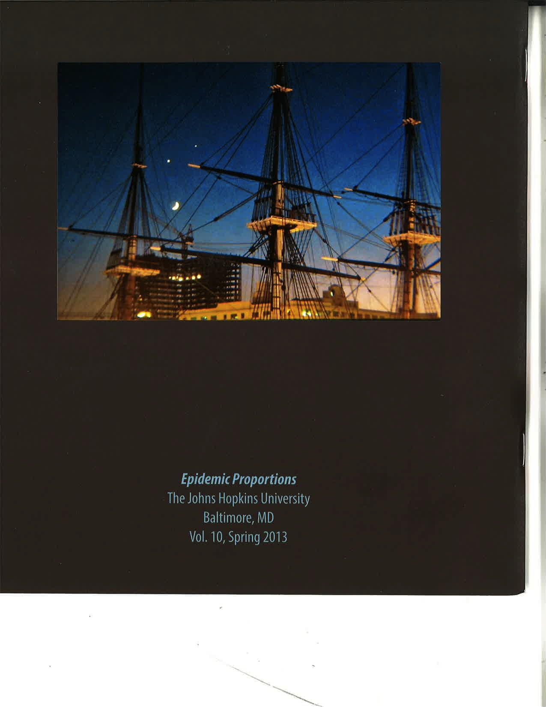
Herman Heyn
Notes:
Crescent Moon, Venus and Jupiter.
Taken from Harborplace, Baltimore, Nov.
25, 1984. Foreground is the 22-gun,
3-masted, USS Constellation, commissioned in
1855, and the last all-sail warship built for the
U.S. Navy. Photo specs.: ISO 400, 50mm FL, 1/2-sec. @ f/2.8.

Slide 10
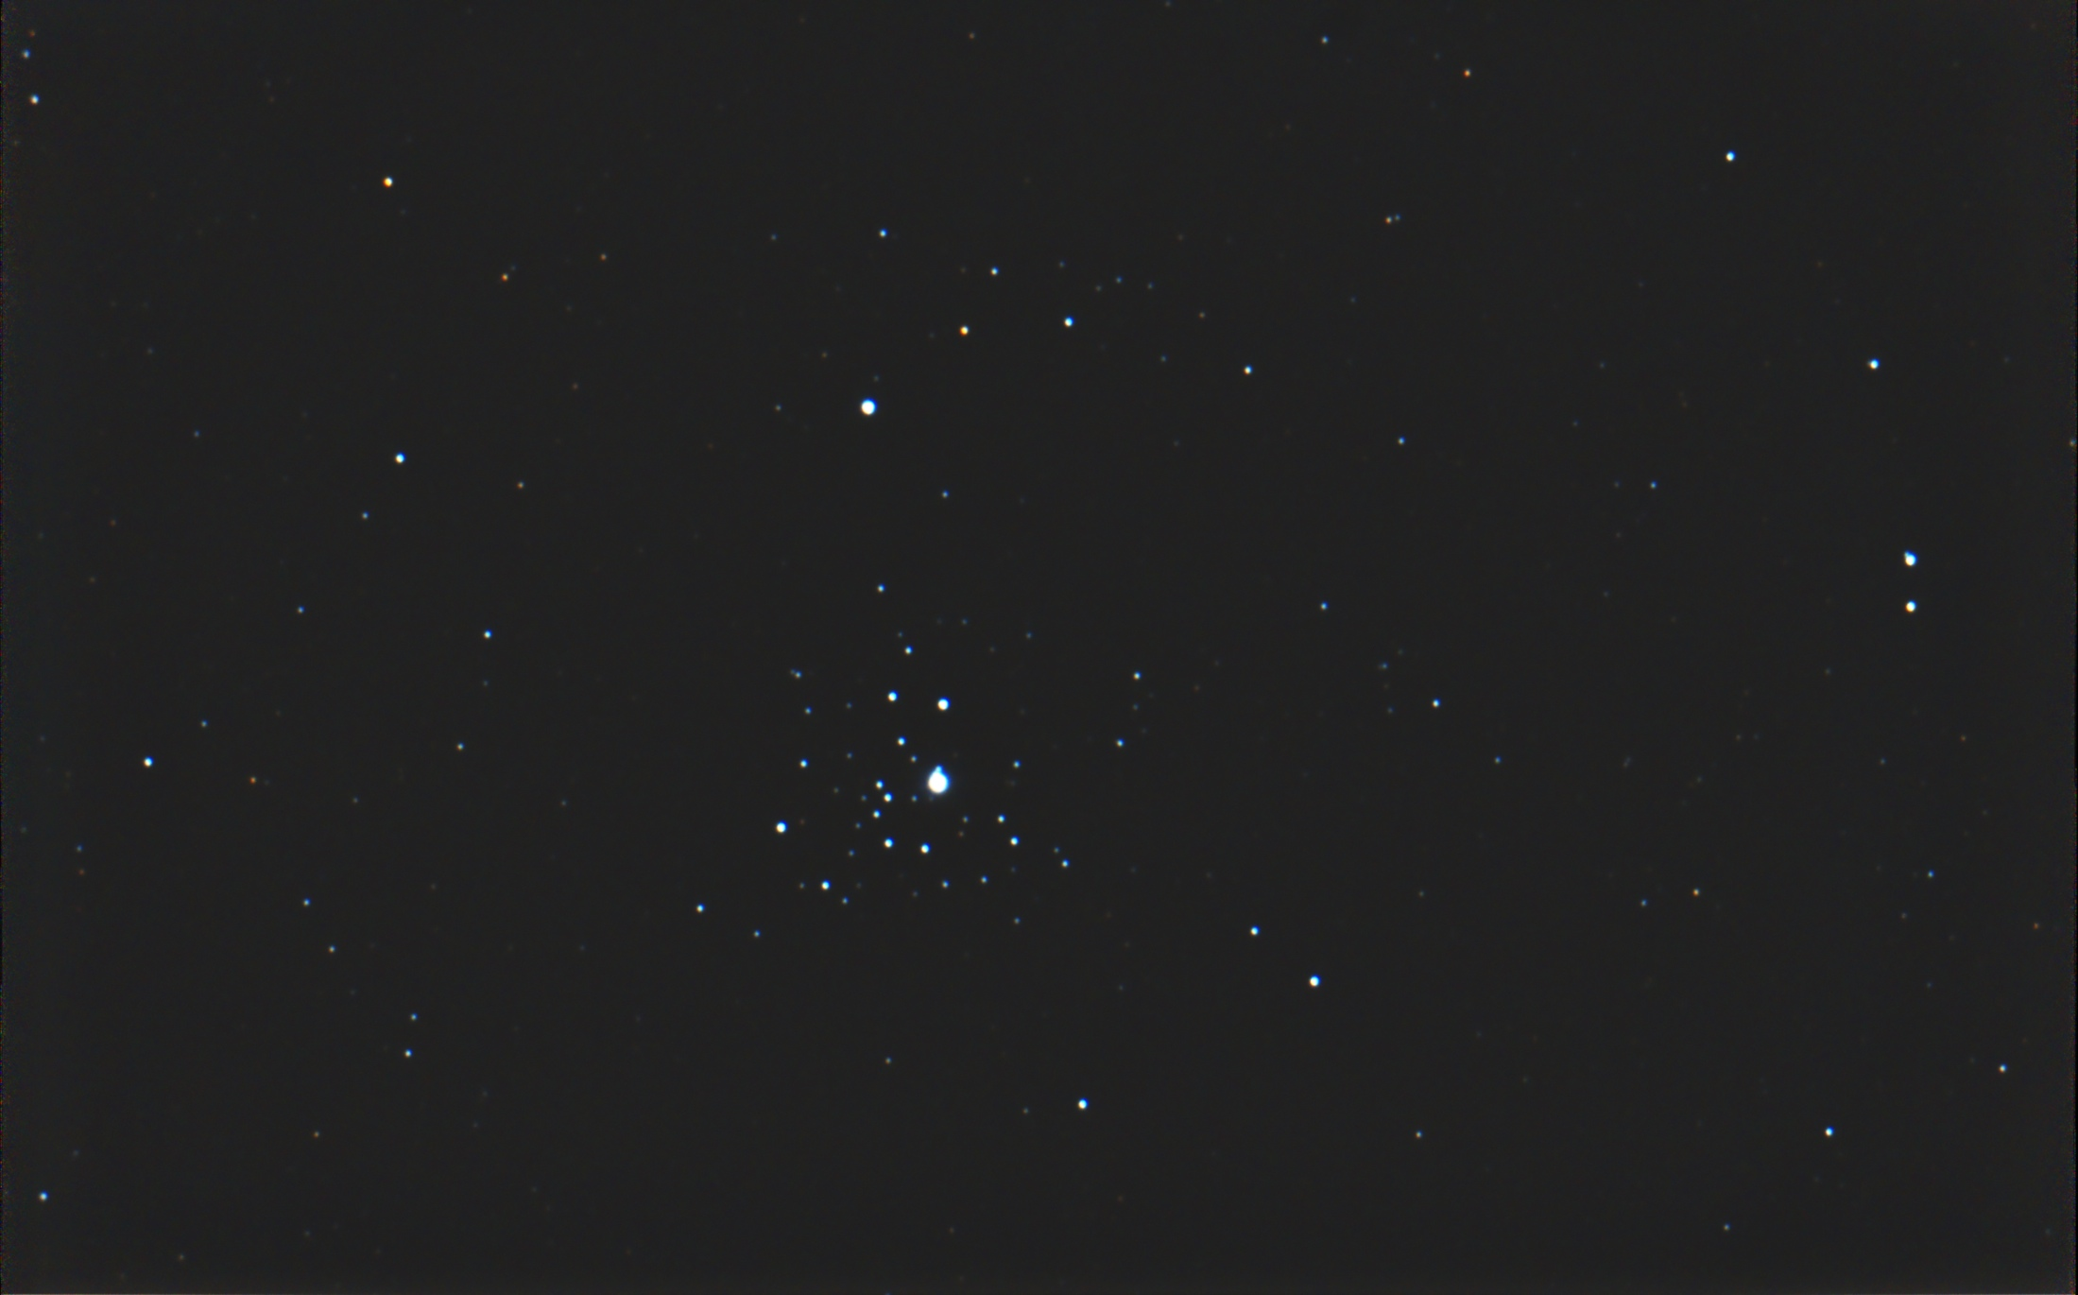
Mike Krauss
Notes:
This is NGC 2362. Bob pointed this one out during our members star party last weekend. It was taken from my back yard, which is a white zone, and the sky was deceptively foggy, but it turned out OK. The image consists of 38 frames of 15 seconds at ISO 1600.

Slide 11
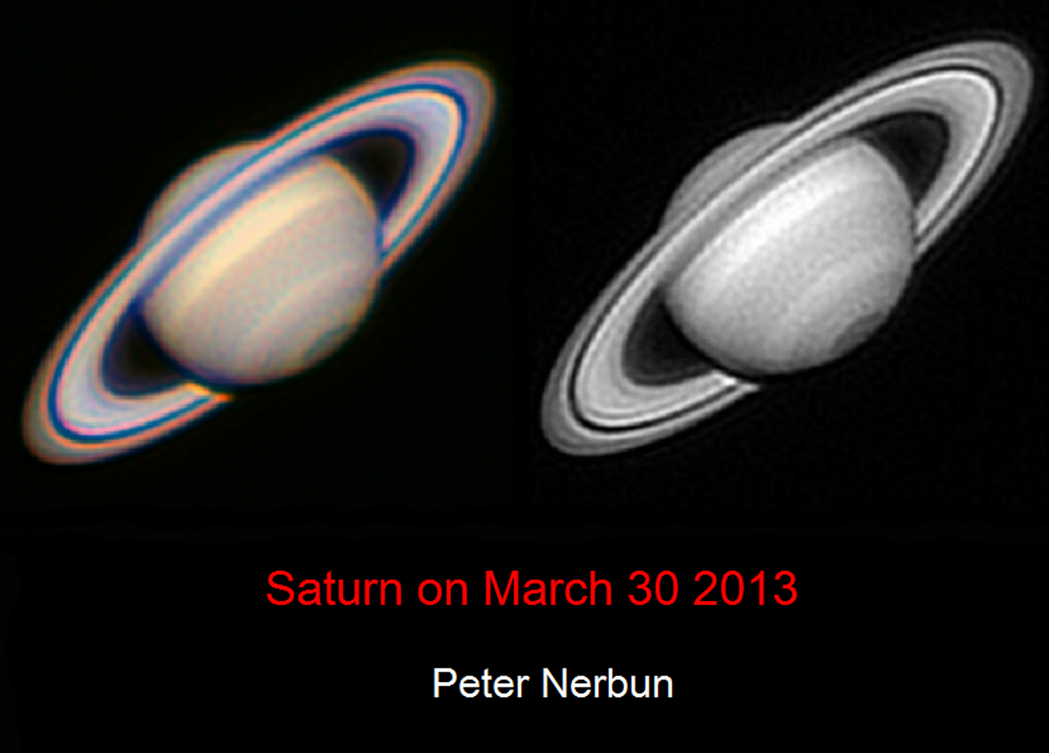

Slide 12
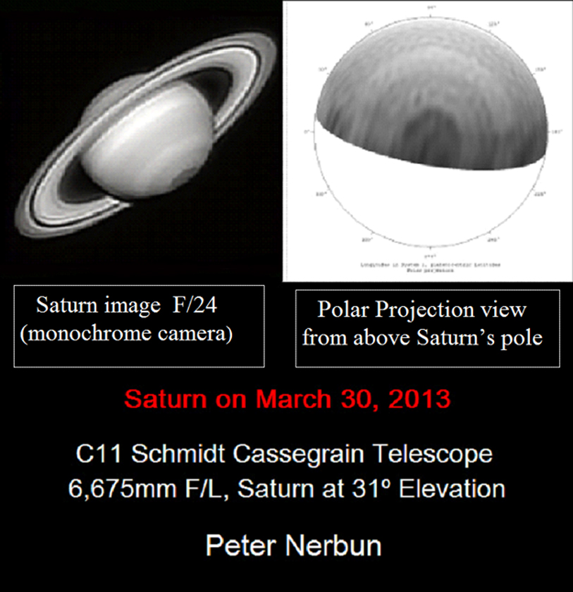

Slide 13
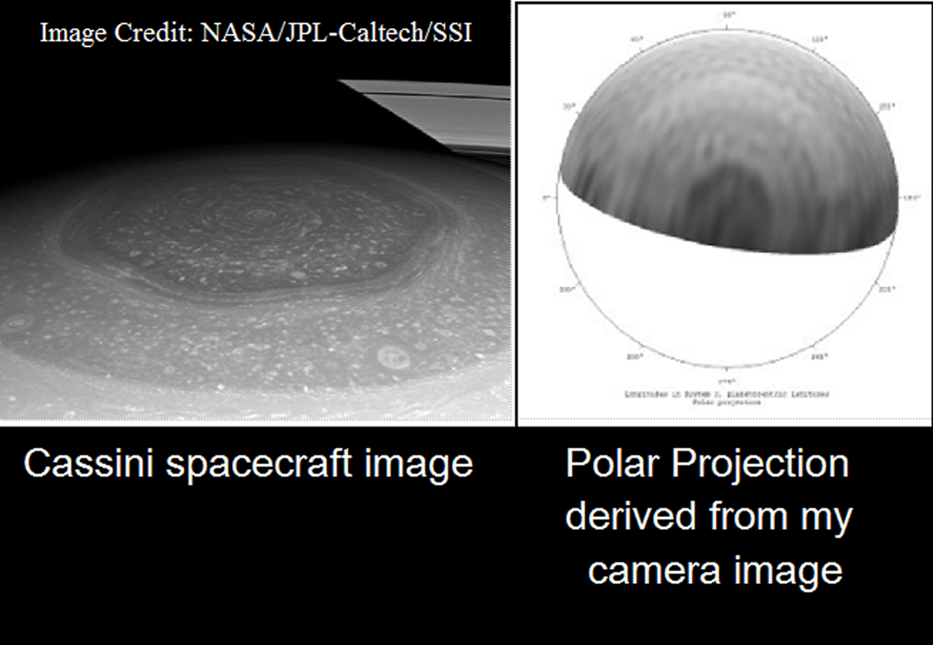
Peter Nerbun

Slide 14
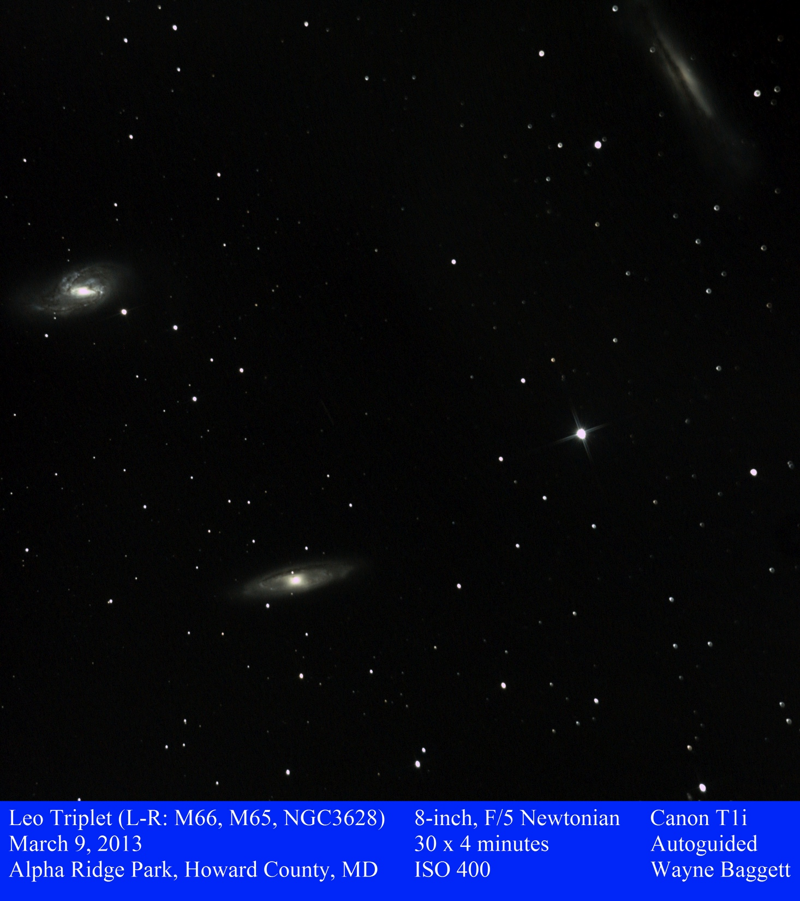

Slide 15
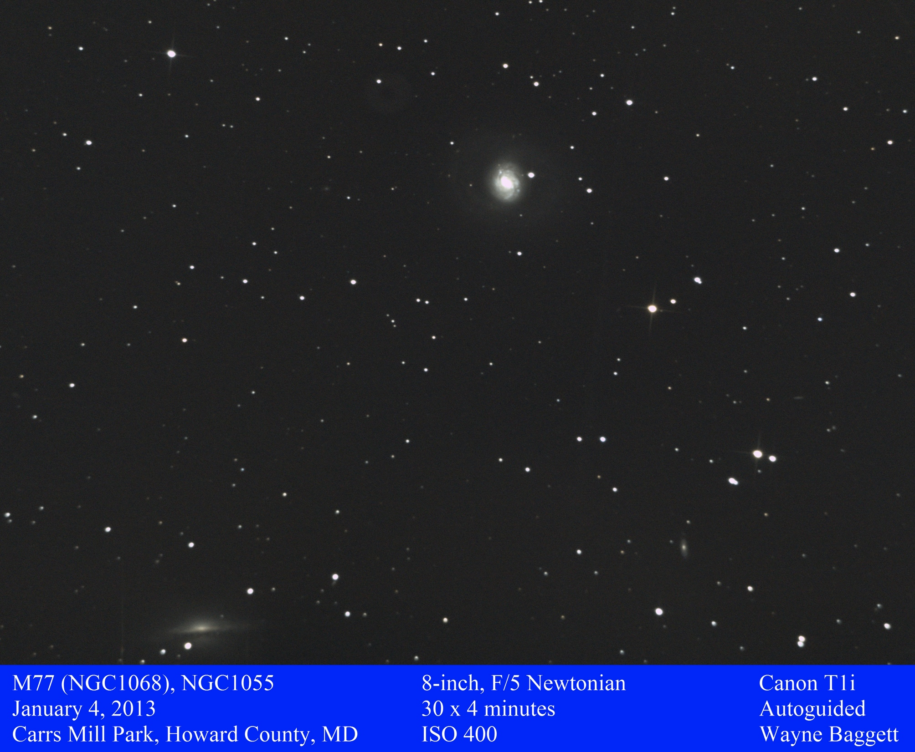

Slide 16
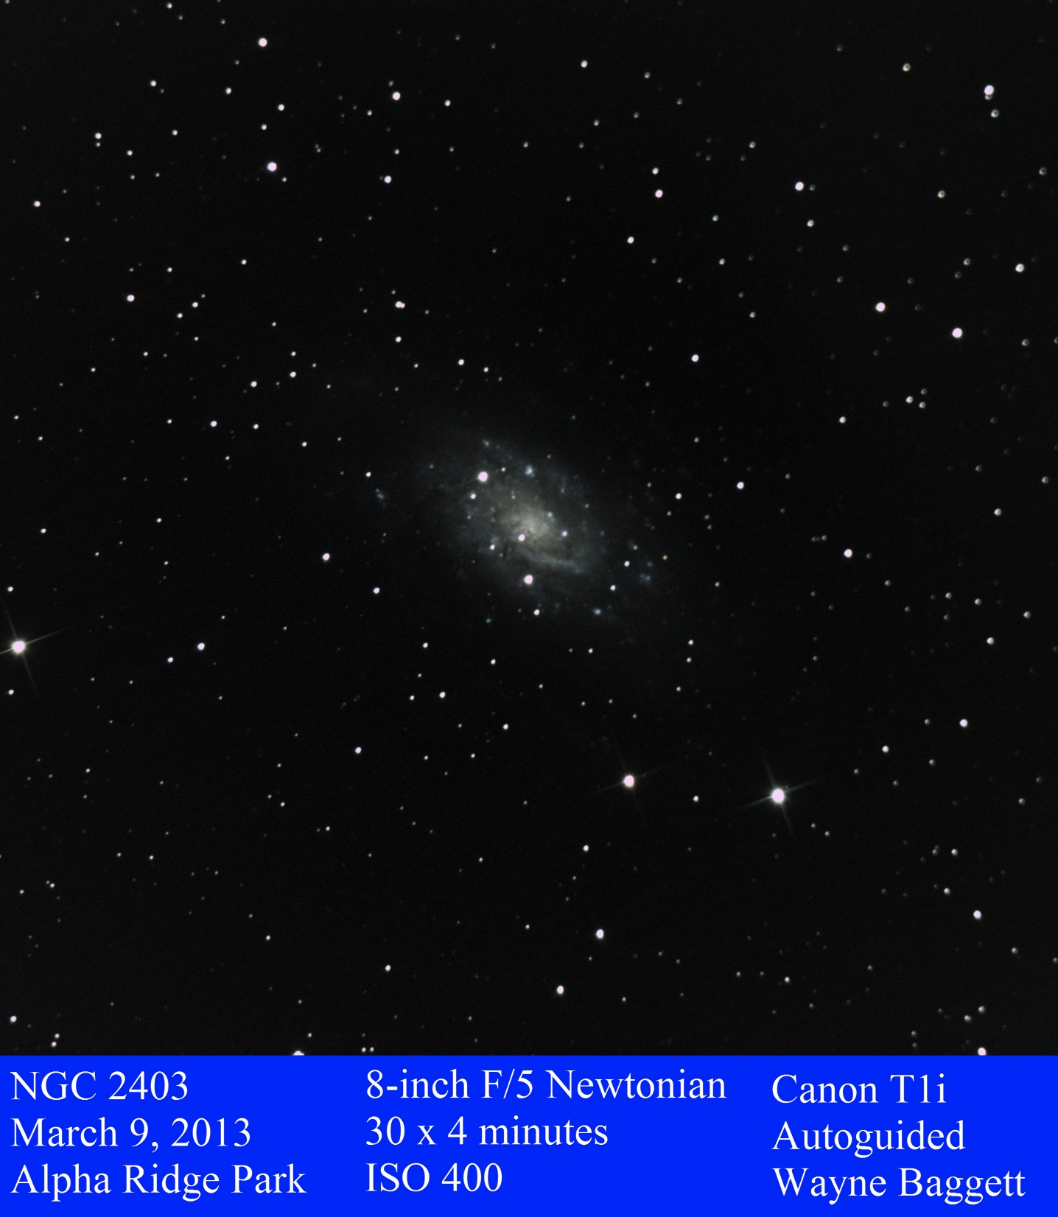

Slide 17
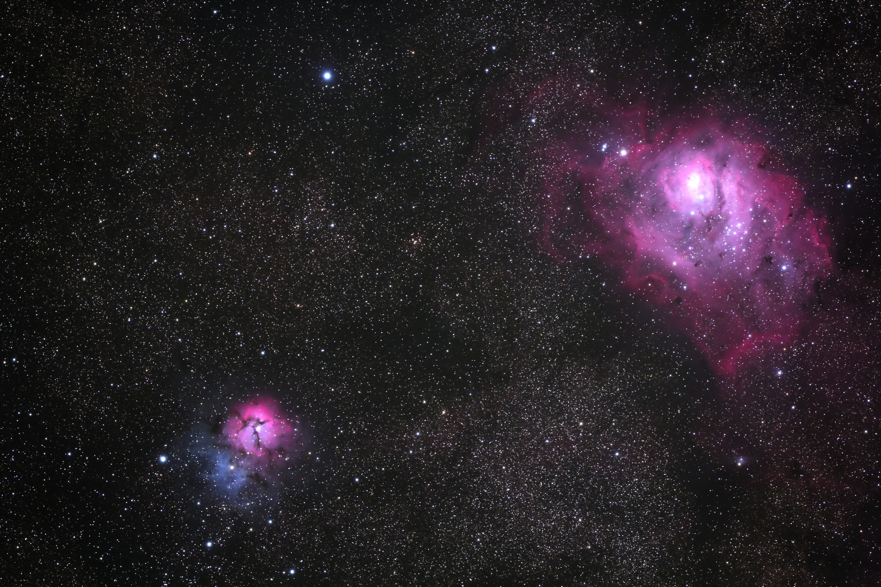
Joe Bohannon

Slide 18
Chris Todd Time-Lapse sequences from
Messier Marathon and Delmarva Stargaze

Slide 19
Stumper answer

Slide 20
As of last night, how many asteroids are visible naked eye (mag > 7)?
D. About 4096
In fact, 4,207 asteroids are currently magnitude 7 or less, with the brightest currently mag 0.9 (2010 KC12), and there are 632 brighter than mag 4!

Slide 21
Thank You!
Next month’s meeting is on Thursday,
May 16, 2013
7:30 PM
Guest speakers:
Dr. K.T. Ramesh from Johns Hopkins:
Impact and fragmentation of asteroids
Joe Bohanon:
Kitt Peak Advanced
Observer Program
Notes:
----- Meeting Notes (3/20/13 22:46) -----
Next month's speaker will tell us how they are using the Hubble to develop a sneak preview of what the James Webb Space Telescope will be capable of.

